Slide 1
UPPER DARBY SCHOOL DISTRICT Beverly Hills Middle School – Track and Field Project Community Meeting @ Beverly Hills Middle School Lobby May 11, 2022
Opportunity · Unity · Excellence

Slide 2
Why are we doing this?
1 | Why this, Why now?
2 | Scope of Work
3 | Community Impact
4 | Questions / Answers
Point of Pride for Our Students & Community
Excellent MS Team
Makes Excellent HS Team
Due for Renovation
Opportunity · Unity · Excellence

Slide 3
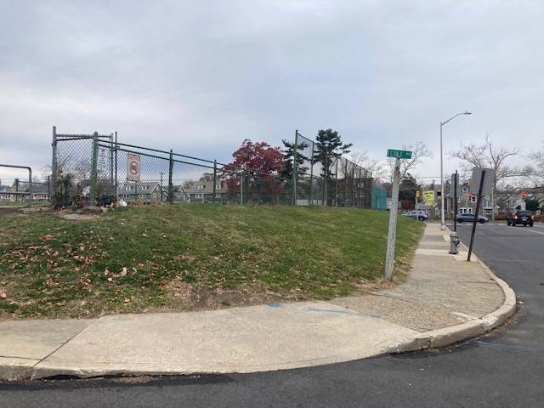
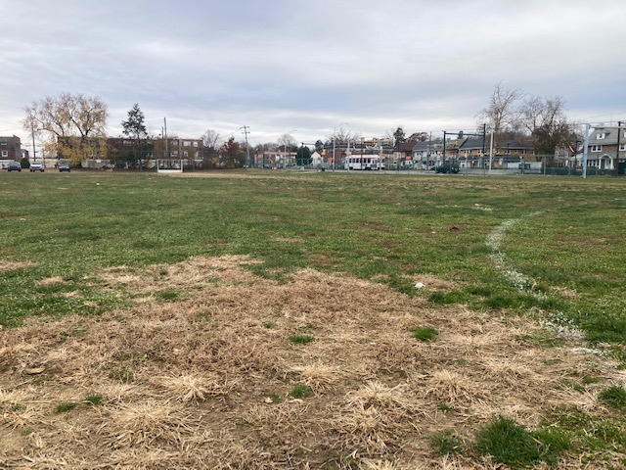
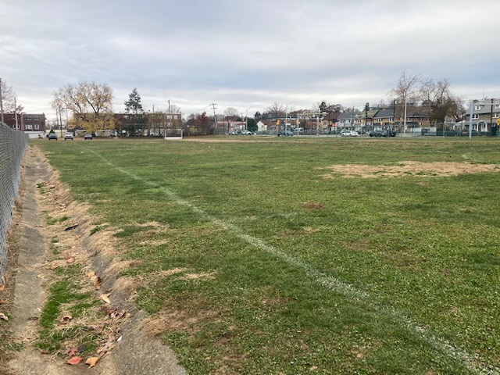
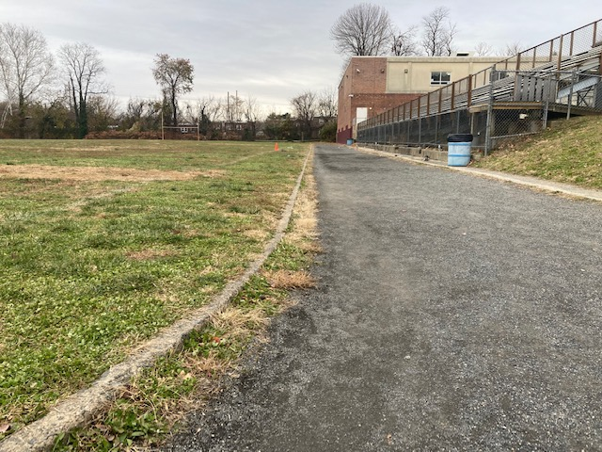
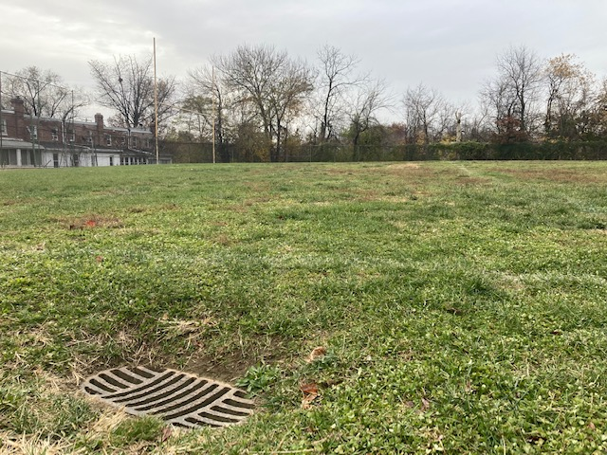
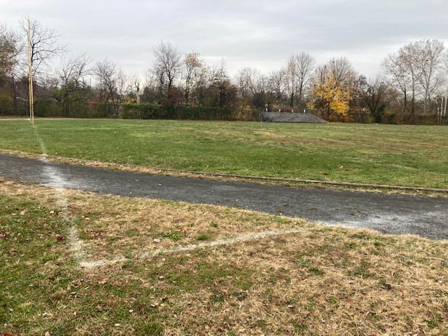
Why are we doing this?
Current Condition along Sherbrook (Front)
Current Field Condition (Front)
Current Field Condition (Front)
Current Outdated Cinder Field (Back)
Current Field Condition (Back)
Undersized Field (Back)
Opportunity · Unity · Excellence

Slide 4
Scope of Work (Front Field Marking)
1 | Why this, Why now?
2 | Scope of Work
3 | Community Impact
4 | Questions / Answers
Center Circle
White Lines – Football
Yellow Lines – Soccer
Orange Lines – Field Hockey
Blue Tick marks – Unified Lacrosse
Opportunity · Unity · Excellence

Slide 5
Scope of Work (Back Track Marking)
1 | Why this, Why now?
2 | Scope of Work
3 | Community Impact
4 | Questions / Answers
Natural Grass Field in the Middle
300M 6 Lanes
High Jump Area
Long Jump Area
Opportunity · Unity · Excellence

Slide 6
Beverly Hills Projects Renderings
Opportunity · Unity · Excellence

Slide 7
Scope of Work – Field and Track Materials
1 | Why this, Why now?
2 | Scope of Work
3 | Community Impact
4 | Questions / Answers
Beynon BSS 300 or Equivalent
Featured Installations:
Harvard University
University of Memphis
FieldTurf – Prestige Vertex
Featured Installations:
Garnet Valley High School Stadium
The Haverford School Sabol Field
HS Track: Mondo
HS Field: Vertex Core
Opportunity · Unity · Excellence

Slide 8
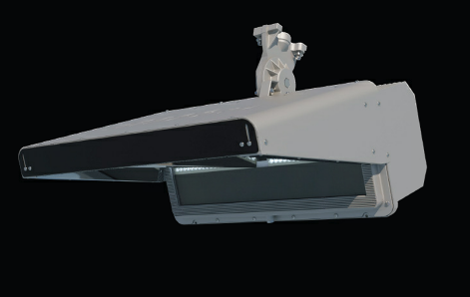
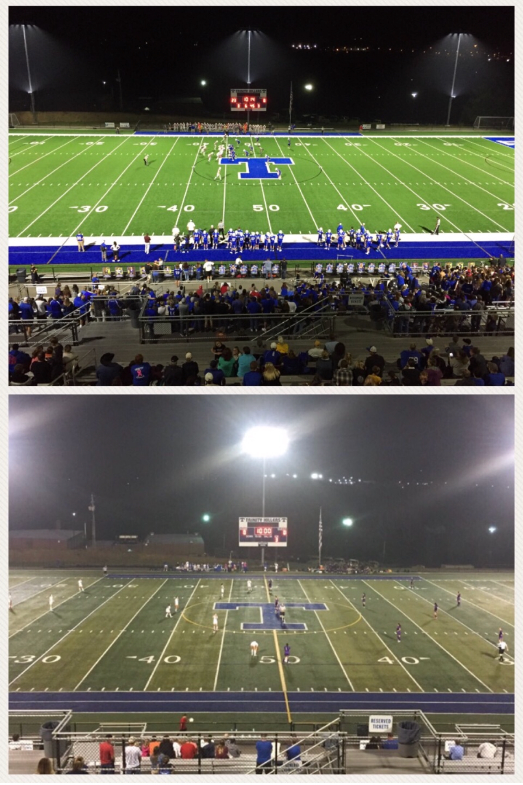
Light Control Matters
What we often see in stadium lighting
The MUSCO Lighting technology we are installing
UDSD’s Lighting Plan was reviewed and approved by the authorities.
Also regionally installed at Northern Lebanon, Milton HS, Cairn University, Pittston HS, Stony Creek Sports, Marple Newtown HS, Great Valley HS, Catasauqua HS, Council Rock South HS, West Chester East, Garden Spot HS, & Holy Family
7

Slide 9
Community Impact – During Construction
1 | Why this, Why now?
2 | Scope of Work
3 | Community Impact
4 | Questions / Answers
Project Launch March 2021
Estimated Construction Start 5/16/2022 (Monday)
Field Project Timeline “Goal” of having the first football game in the Fall 2022
Tracks Project Timeline Late Fall 2022 or
Before 2023 Track Season
Usual Operating Hours 7 AM – 4 PM (Occasional Weekends)
Disclaimer:
There is a major shortage of labor, equipment and materials in the construction industry!!!
We may experience further delays.
Opportunity · Unity · Excellence

Slide 10
Construction Logistics
7
3
Construction entrance
Temporary fence line
Pedestrian gate will be locked
Ecole Avenue: Parking still available
Tree protection fence
4 – 5 parking spaces taken away
A new school zone flasher for our students
5
1
2
6
4
Opportunity · Unity · Excellence

Slide 11
Construction Logistics
3
Construction Entrance
Temporary Fence Line
Gate from the school will be Locked
2
1
Opportunity · Unity · Excellence

Slide 12
Community Impact – After Construction
1 | Why this, Why now?
2 | Scope of Work
3 | Community Impact
4 | Questions / Answers
School Use Our students will enjoy the new field and track during and after school hours
Community The track will be open to the community
Available time will be posted publicly
No dogs allowed on the track and field
Youth Groups The Field and Track will be accessible to Upper Darby’s Youth Athletic Groups per the District’s Use of Facilities Policy
Opportunity · Unity · Excellence

Slide 13
One More Thing (Drexel Hill MS)
Opportunity · Unity · Excellence

Slide 14
Thank you for coming! Continue sharing your questions and concerns to Marvin Lee @ MLee@Upperdarbysd.org

