Slide 1



UPPER DARBY
SCHOOL DISTRICT
Drexel Hill Middle School – Track and Field Project
Community Meeting @ Drexel Hill Middle School Library
April 27, 2022
Opportunity · Unity · Excellence

Slide 2

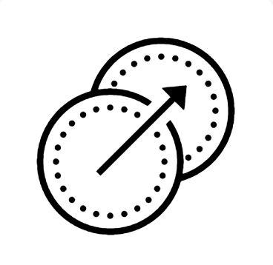
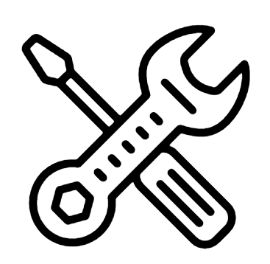
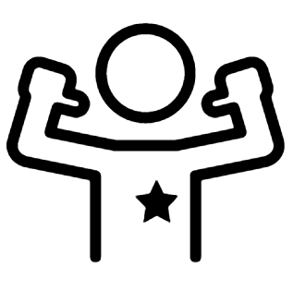
Why are we doing this?
1 | Why this, Why now?
2 | Scope of Work
3 | Community Impact
4 | Questions / Answers
Point of Pride for Our Students & Community
Excellent MS Team
Makes Excellent HS Team
Due for Renovation
Opportunity · Unity · Excellence

Slide 3
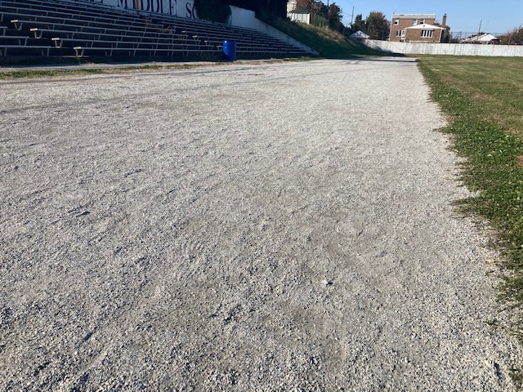
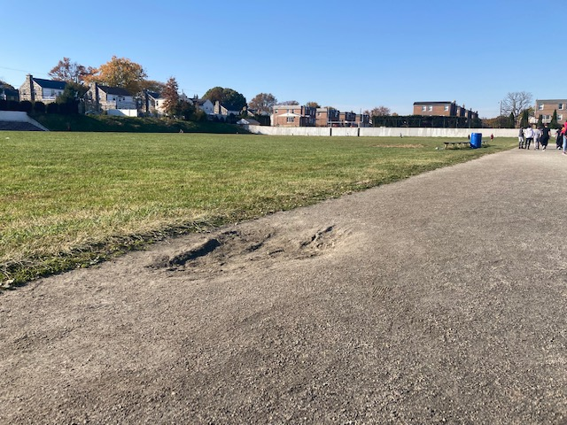
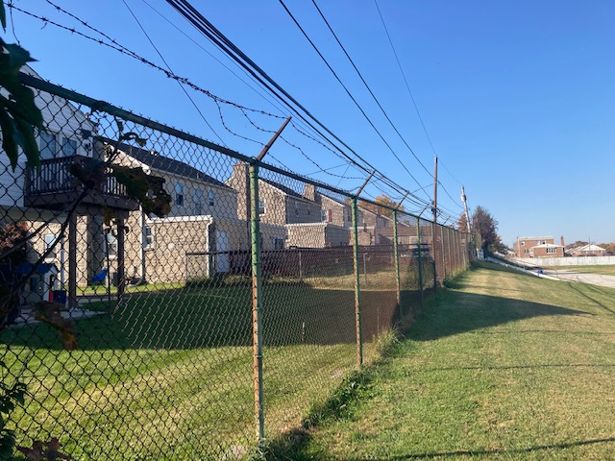
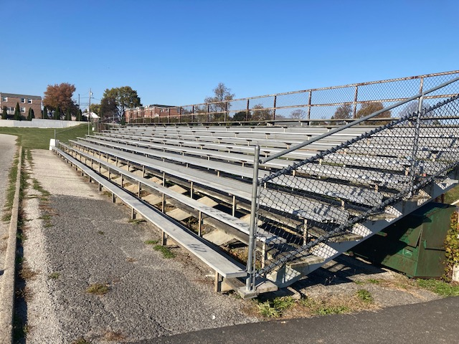
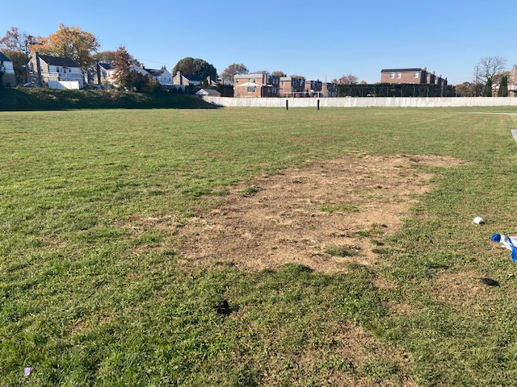
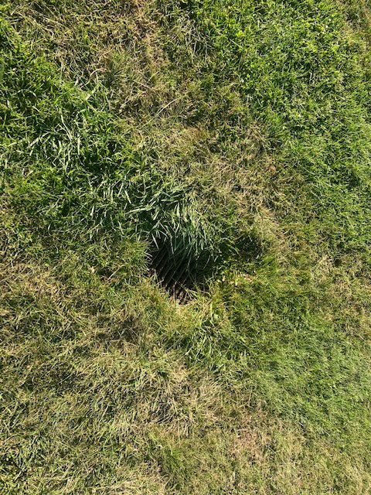
Why are we doing this?
Opportunity · Unity · Excellence

Slide 4
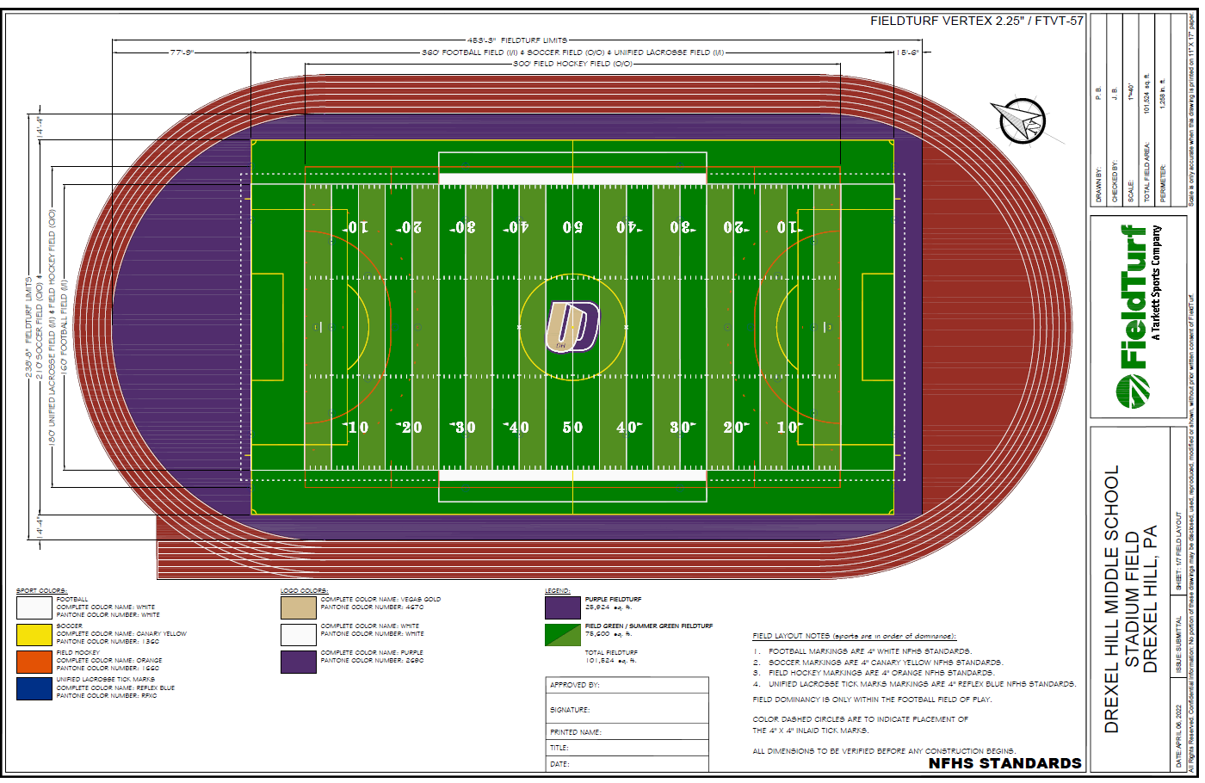
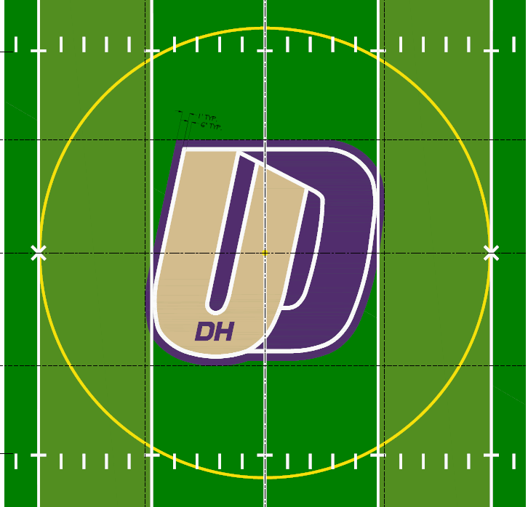
Scope of Work (Field Marking)
1 | Why this, Why now?
2 | Scope of Work
3 | Community Impact
4 | Questions / Answers
Center Circle
6 Lane 400M Track
White Lines – Football
Yellow Lines – Soccer
Orange Lines – Field Hockey
Blue Tick marks – Unified Lacrosse
Opportunity · Unity · Excellence

Slide 5
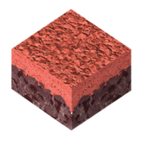
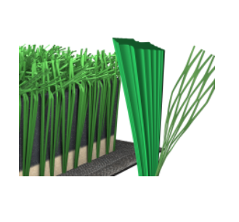
Scope of Work – Field and Track Materials
1 | Why this, Why now?
2 | Scope of Work
3 | Community Impact
4 | Questions / Answers
Beynon BSS 300 or Equivalent
Featured Installations:
Harvard University
University of Memphis
FieldTurf – Prestige Vertex
Featured Installations:
Garnet Valley High School Stadium
The Haverford School Sabol Field
HS Track: Mondo
HS Field: Vertex Core
Opportunity · Unity · Excellence

Slide 6
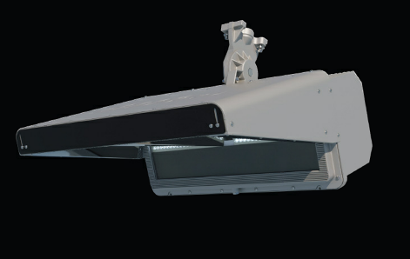
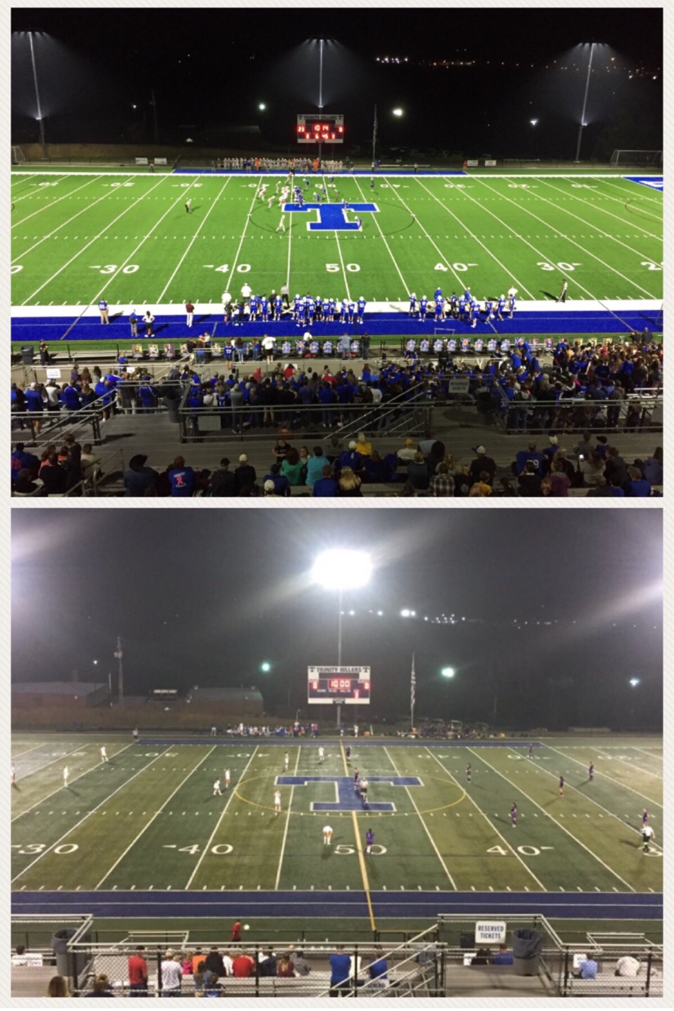
Light Control Matters
What we often see in stadium lighting
The MUSCO Lighting technology we are installing
UDSD’s Lighting Plan was reviewed and approved by the authorities.
Also regionally installed at Northern Lebanon, Milton HS, Cairn University, Pittston HS, Stony Creek Sports, Marple Newtown HS, Great Valley HS, Catasauqua HS, Council Rock South HS, West Chester East, Garden Spot HS, & Holy Family
5

Slide 7
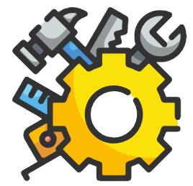
Community Impact – During Construction
1 | Why this, Why now?
2 | Scope of Work
3 | Community Impact
4 | Questions / Answers
Project Launch March 2021
Estimated Construction Start 5/2/2022 (Monday)
Field Project Timeline “Goal” of having the first football game in the Fall 2022
Tracks Project Timeline Late Fall 2022 or
Before 2023 Track Season
Usual Operating Hours 7 AM – 4 PM (Occasional Weekends)
Disclaimer:
There is a major shortage of labor, equipment and materials in the construction industry!!!
We may experience further delays.
Opportunity · Unity · Excellence

Slide 8
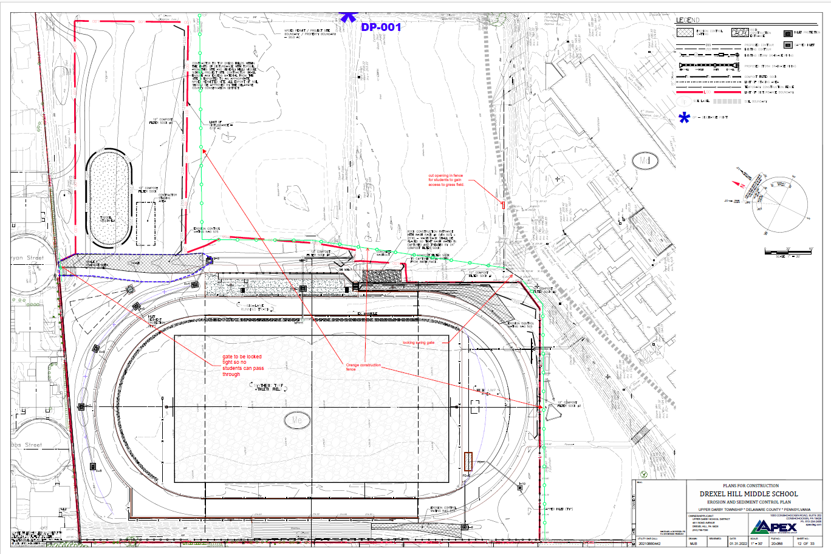
Construction Logistics
Bryan St. Gate will be locked during the construction
Erosion Control Matting
Red Line: Limit of Disturbance / Boundary of Construction Site
Teal Line: Temporary Construction Fence
Cut out an opening for Students to use grass field
New Grass Field and a Berm – 12 months waiting period
Construction Site Entrance
Baseball Field
Existing Tennis Court
6
8
5
1
2
4
7
9
3
Opportunity · Unity · Excellence

Slide 9
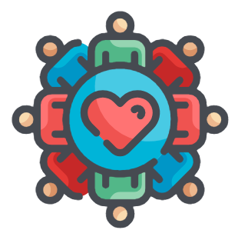
Community Impact – After Construction
1 | Why this, Why now?
2 | Scope of Work
3 | Community Impact
4 | Questions / Answers
School Use Our students will enjoy the new field and track during and after school hours
Community The track will be open to the community
Available time will be posted publicly
No dogs allowed on the track and field
Youth Groups The Field and Track will be accessible to Upper Darby’s Youth Athletic Groups per the District’s Use of Facilities Policy
Opportunity · Unity · Excellence

Slide 10
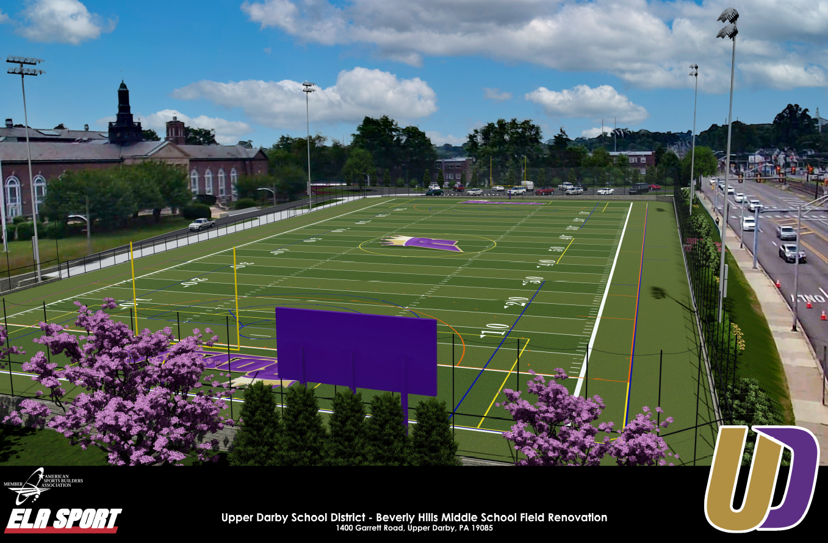
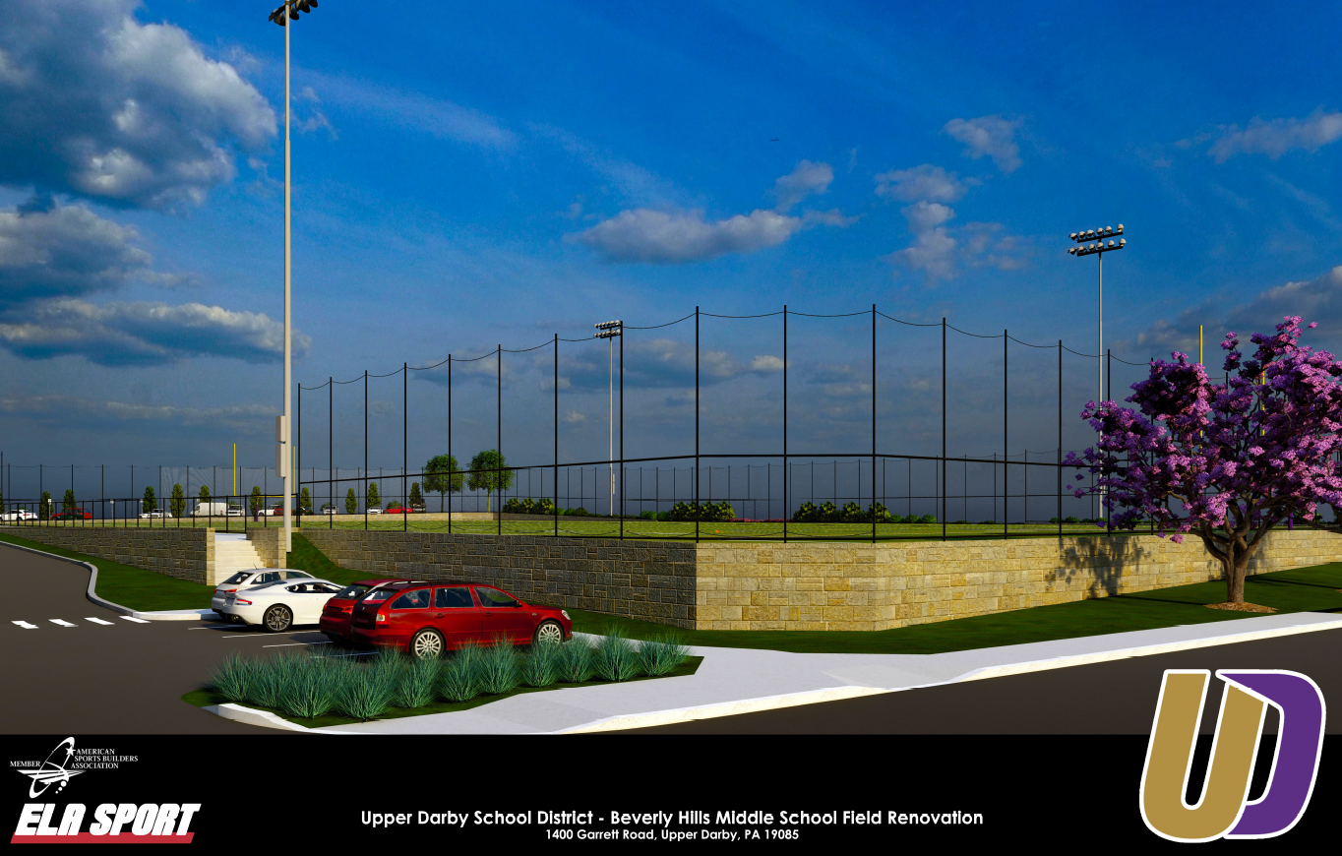
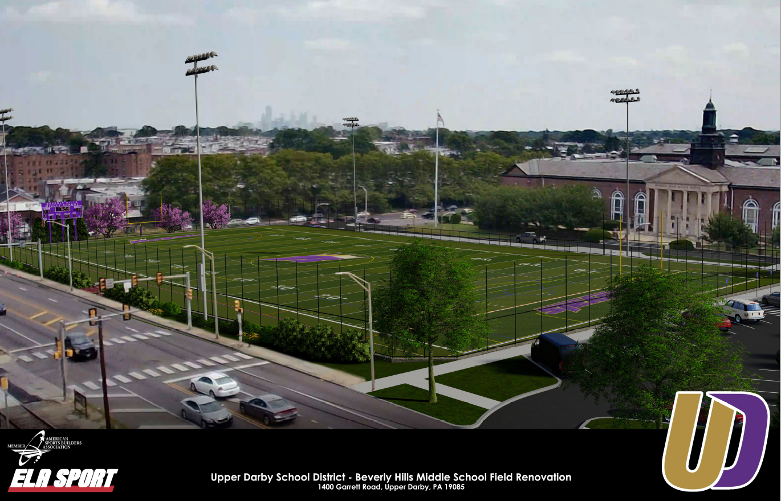
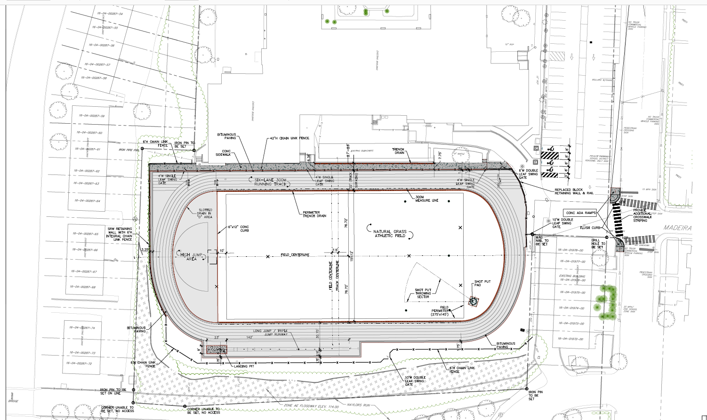
One More Thing (Beverly Hills MS)
Opportunity · Unity · Excellence

Slide 11
Thank you for coming!
Continue sharing your questions and concerns to Marvin Lee @ MLee@Upperdarbysd.org

